Slide 1
Computer Networks Fall 2023
Programing Assignment
5. Data link Layer Assignment
Hou Huawei
1136288430@qq.com
Zhixin Building N201

Slide 2
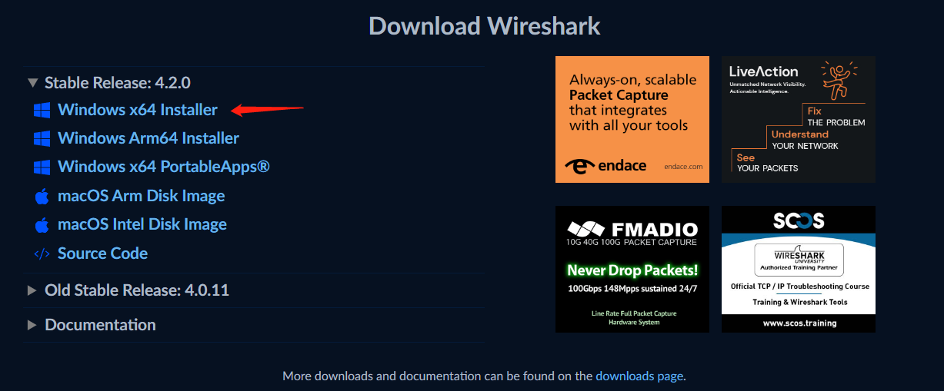
Wireshark experiments
Wireshark install
(1) download stable release install file in
(2) install it with default setting
https://www.wireshark.org/

Slide 3
Ethernet frame analyzing
http://www-net.cs.umass.edu/wireshark-labs/Wireshark_Ethernet_ARP_v8.0.pdf
(1) download experiment document
(2) download traces file in
(3) open file ethernet--ethereal-trace-1 in wireshark
(4) answer questions in Page 4 of the document
(5) try to Capture and analyze Ethernet frames by yourself, and compare with the provided frame
http://www-net.cs.umass.edu/wireshark-labs/wireshark-traces.zip
https://gaia.cs.umass.edu/kurose_ross/wireshark.php

Slide 4
以太网帧分析
http://www-net.cs.umass.edu/wireshark-labs/Wireshark_Ethernet_ARP_v8.0.pdf
（1） 下载实验文档
（2） 在()中下载跟踪文件
（3） 打开文件以太网--wireshark中的ethereal-trace-1
（4） 回答文件第4页中的问题
（5） 尝试自己捕获和分析以太网帧，并与提供的帧进行比较
http://www-net.cs.umass.edu/wireshark-labs/wireshark-traces.zip
https://gaia.cs.umass.edu/kurose_ross/wireshark.php

Slide 5
Address Resolution Protocol
(1) open file ethernet--ethereal-trace-1 in wireshark
(2) analyze ARP frames
(3) answer questions 10, 11, 13 and 14 in the document
(4) try to Capture and analyze ARP frames by yourself, and compare with the provided frame

Slide 6
地址解析协议
（1） 打开文件以太网--wireshark中的ethereal-trace-1
（2） 分析ARP帧
（3） 回答文档中的问题10、11、13和14
（4） 尝试自己捕获和分析ARP帧，并与提供的帧进行比较

